Slide 1
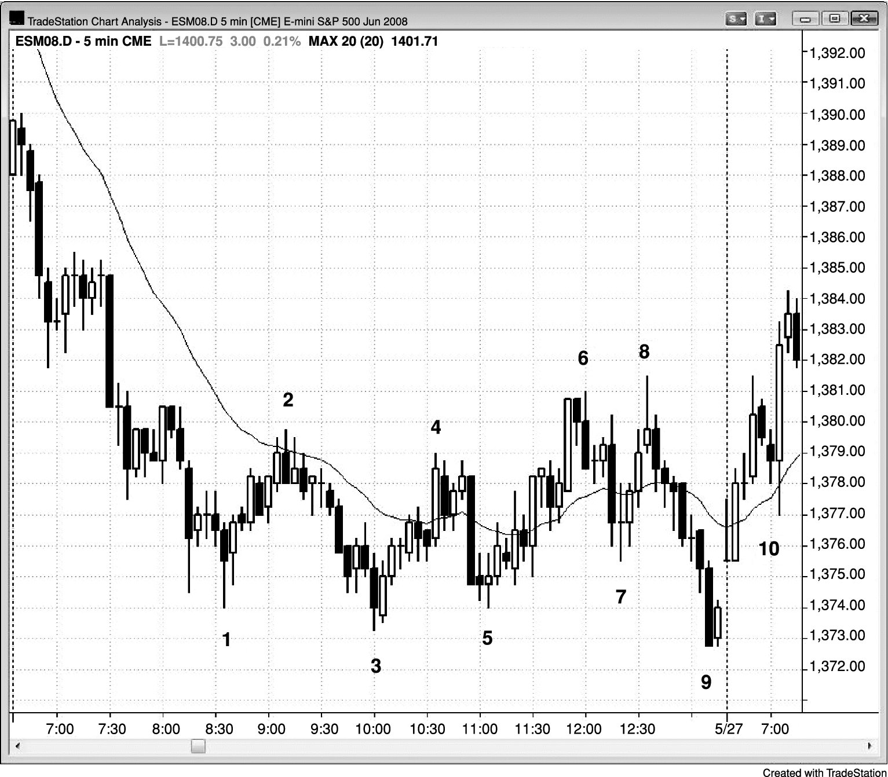
FIGURE 18.1 Wedge Bear Flag and Expanding Triangle

Slide 2
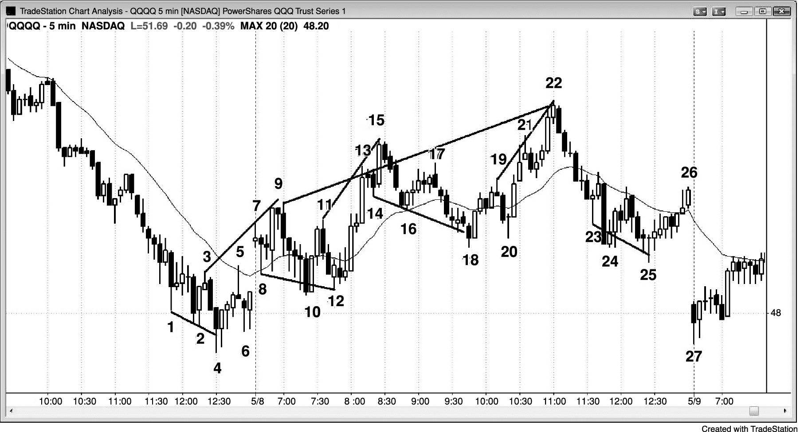
FIGURE 18.2 Wedge Bear Flag

Slide 3
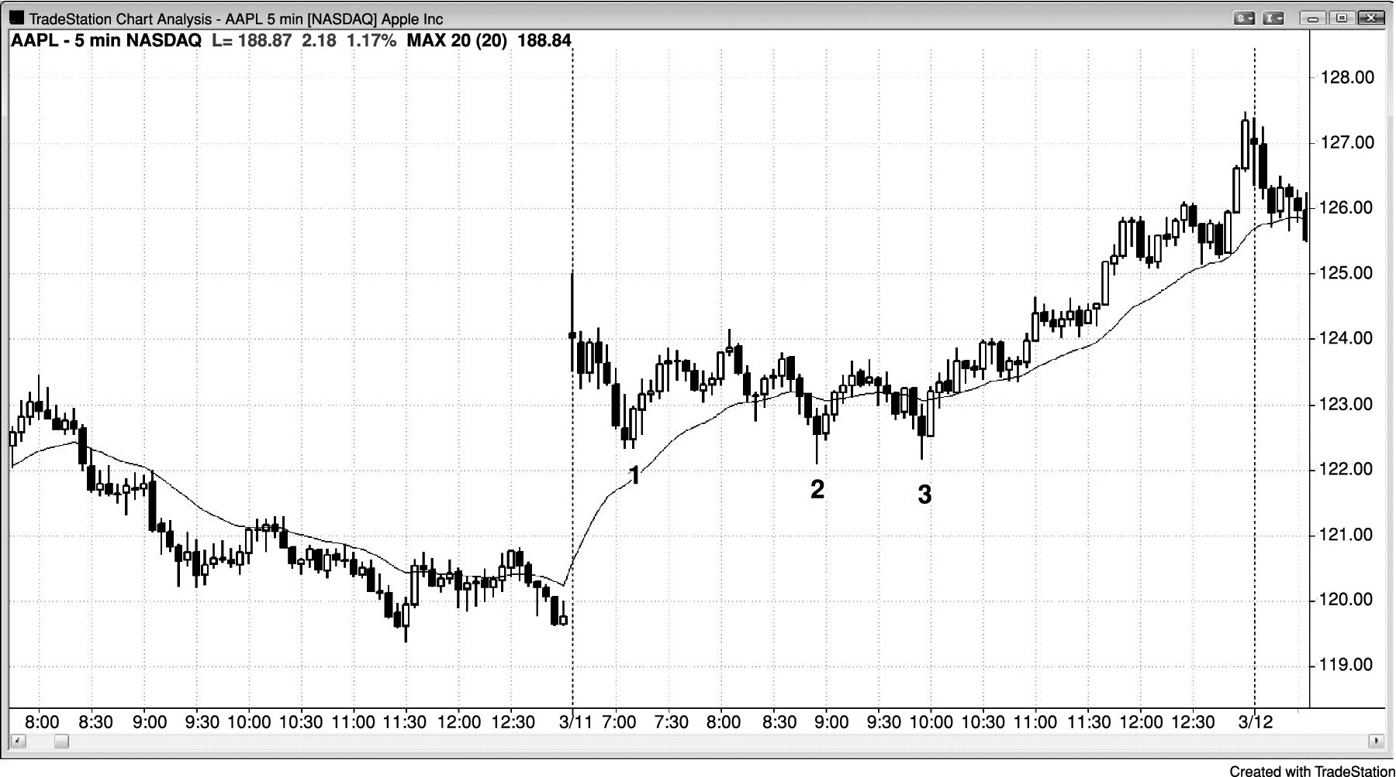
FIGURE 18.3 Gap Up and Wedge Bull Flag

Slide 4
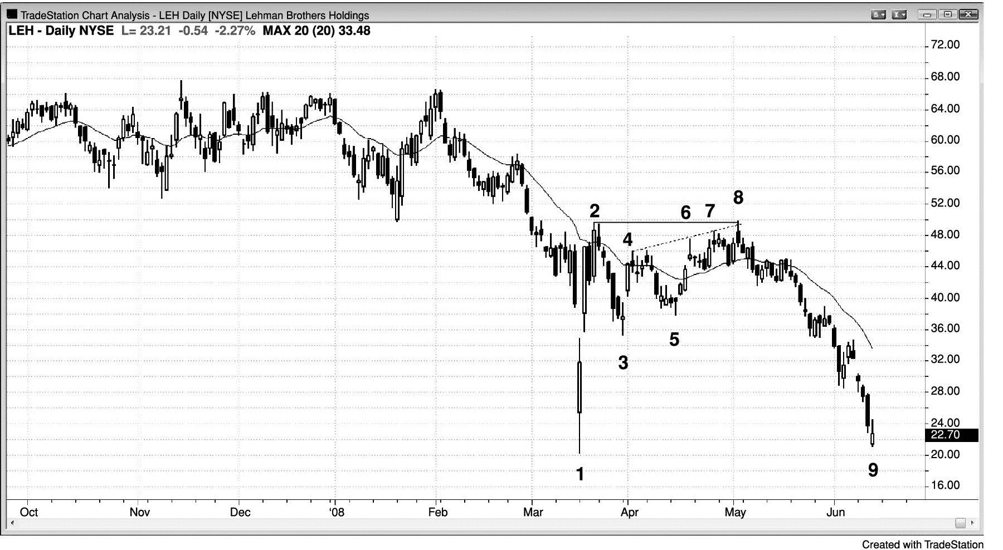
FIGURE 18.4 Wedge Bear Flag

Slide 5
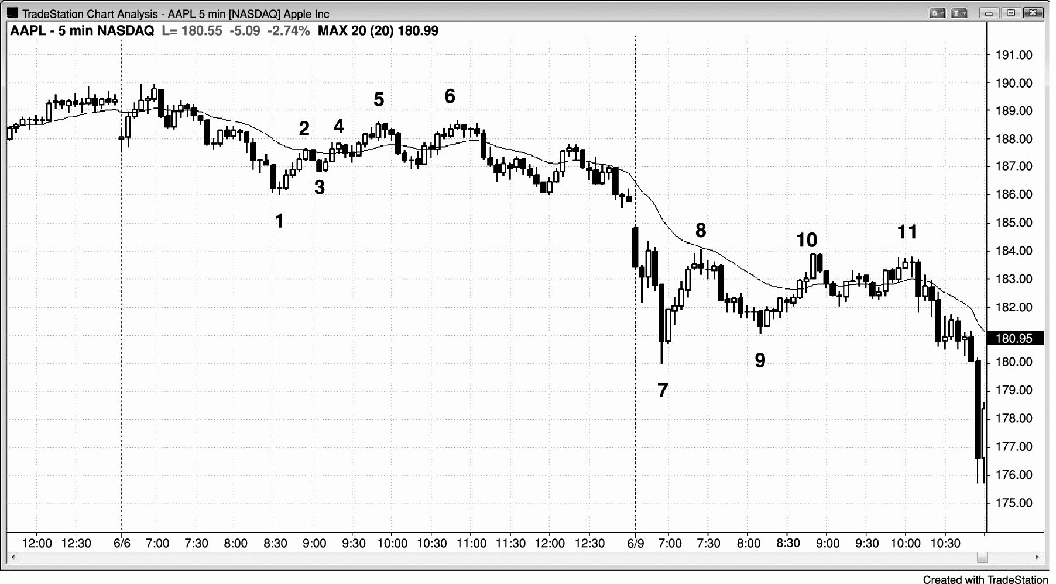
FIGURE 18.5 Higher High Breakout Pullback from Wedge Bear Flag

Slide 6
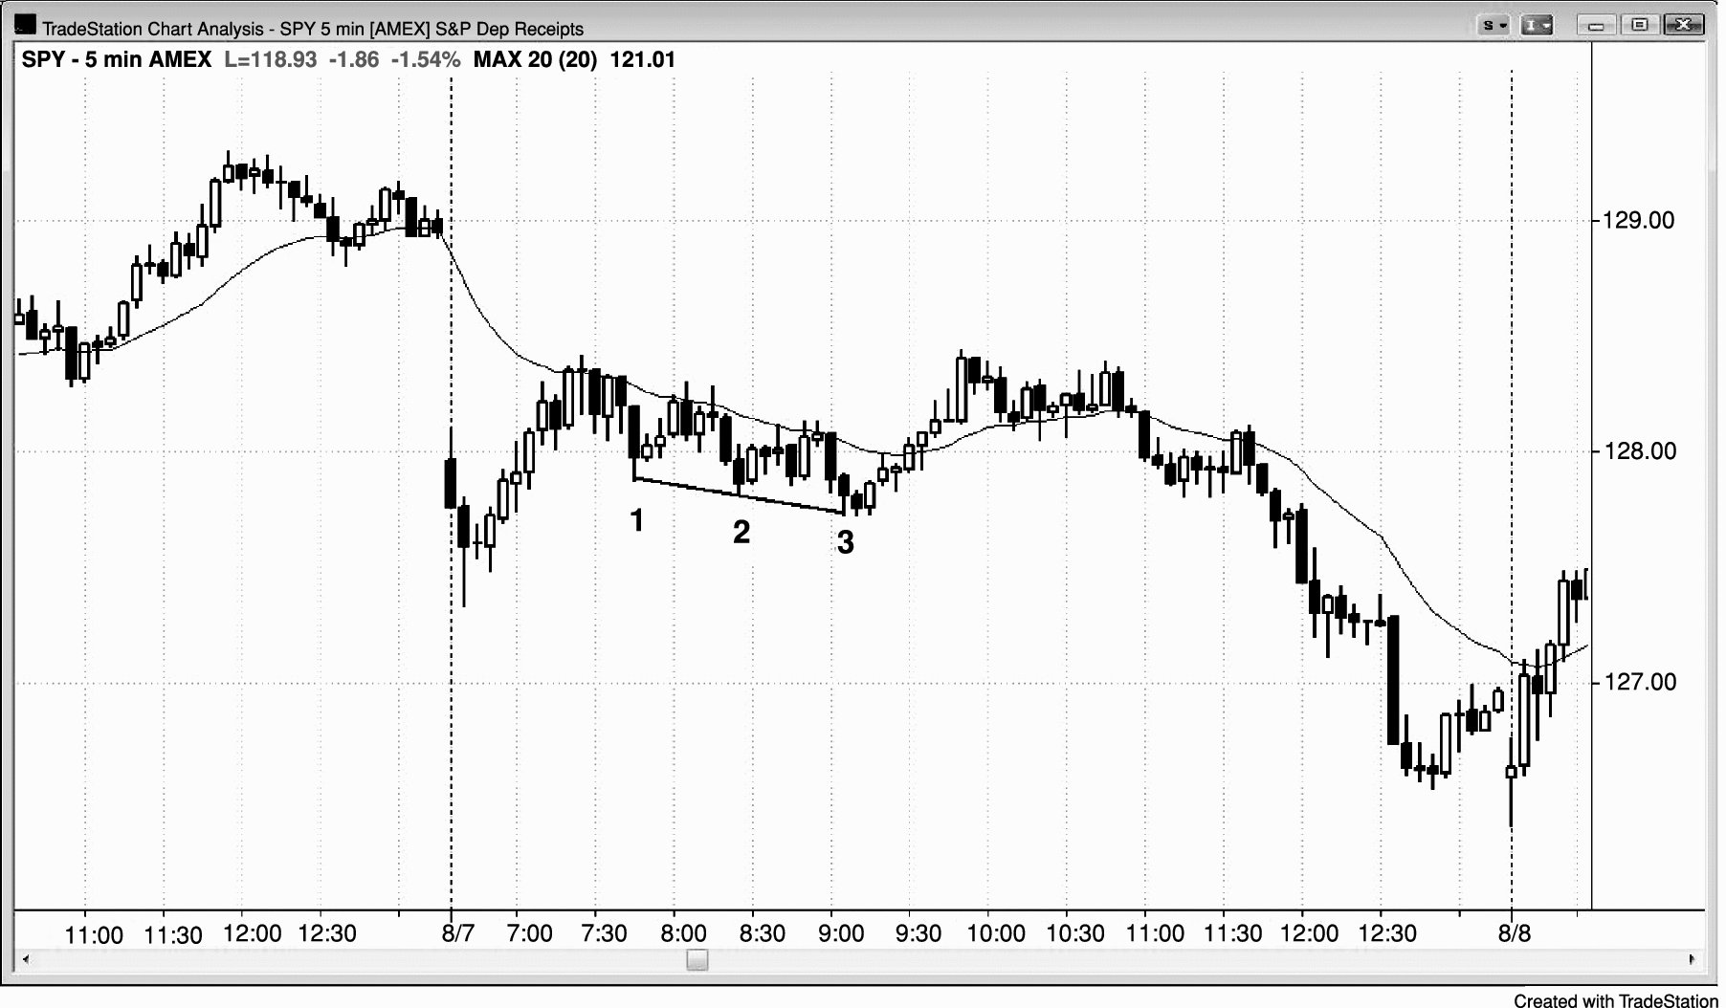
FIGURE 18.6 Spike and Channel as Wedge Bull Flag

Slide 7
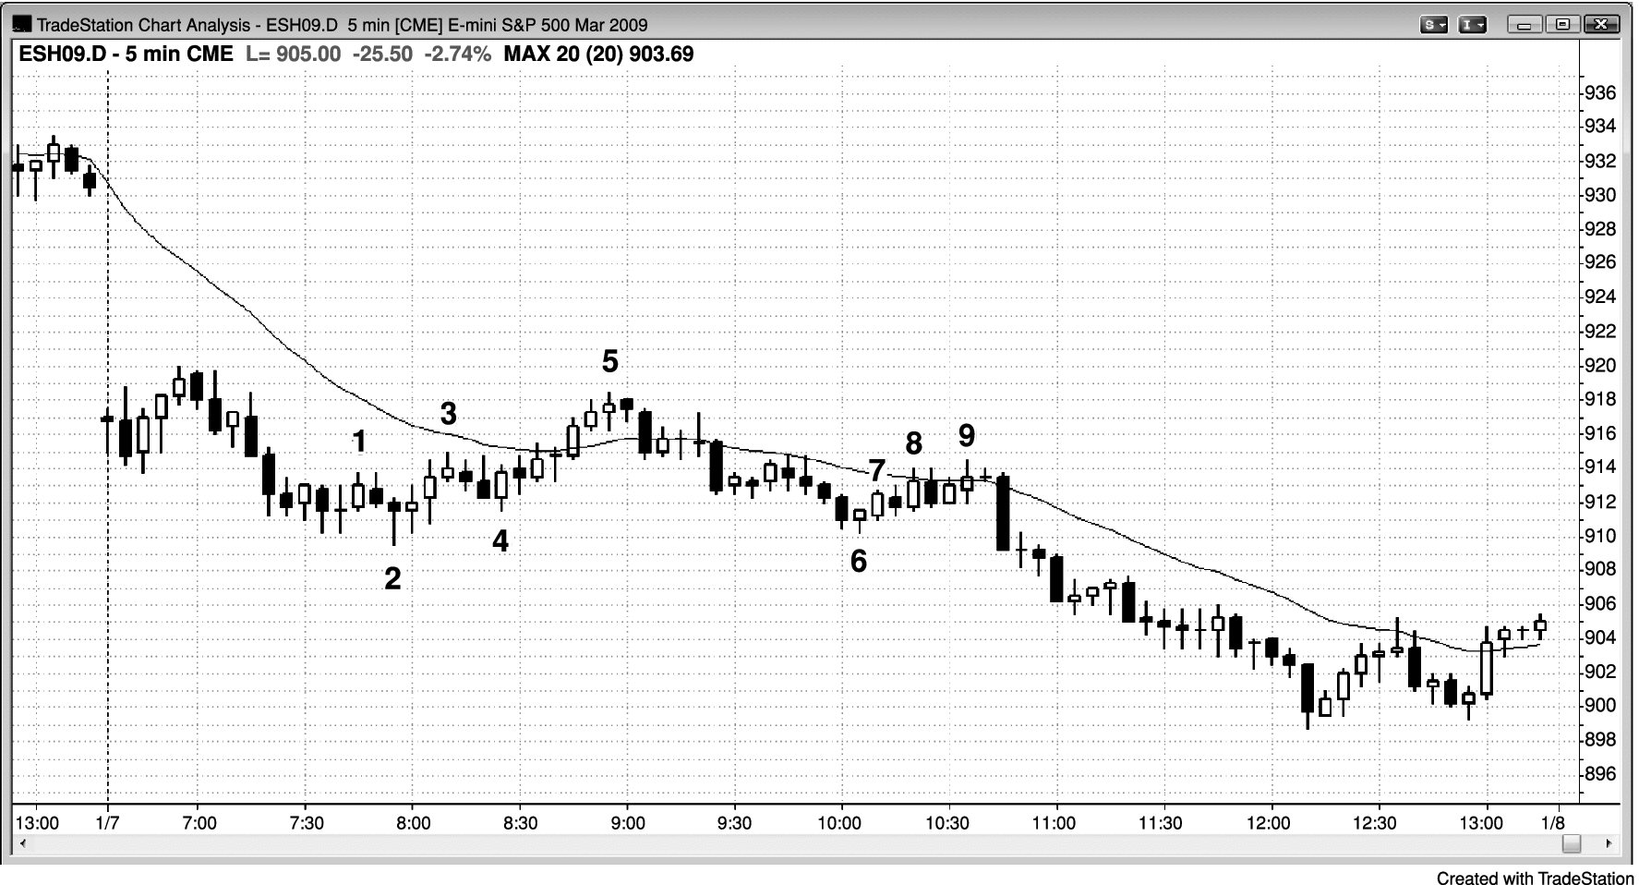
FIGURE 18.7 Wedge Flags

Slide 8
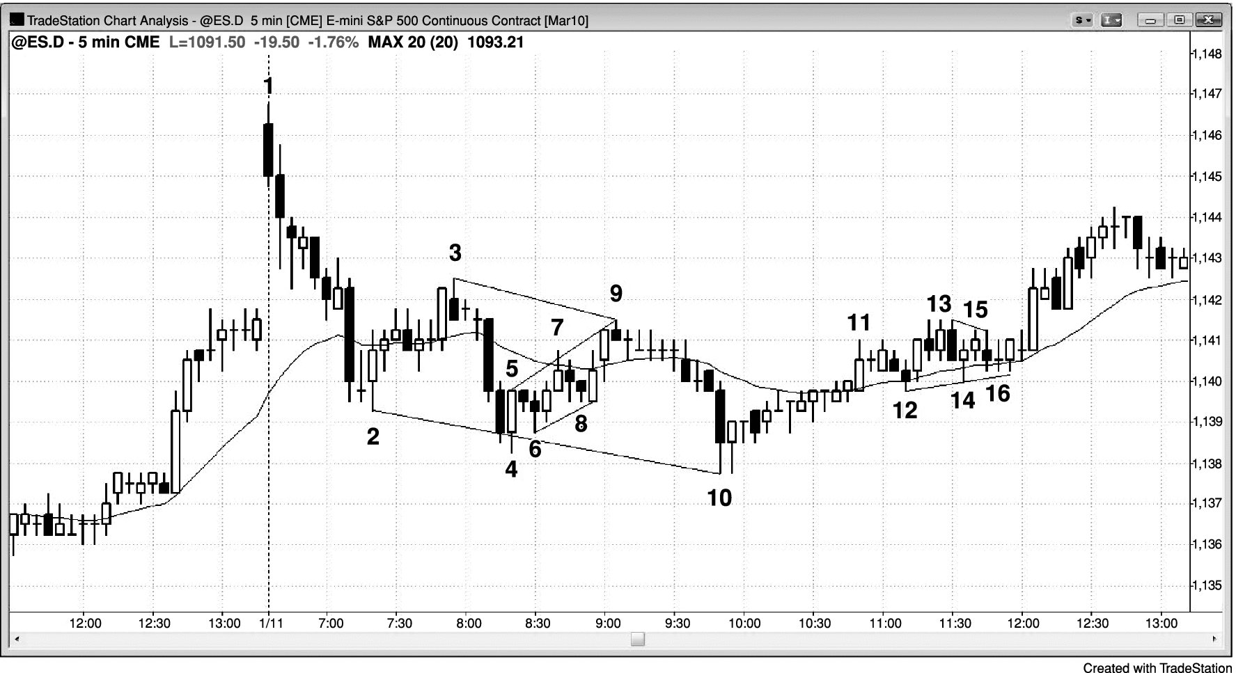
FIGURE 18.8 Three-Push Patterns

Slide 9
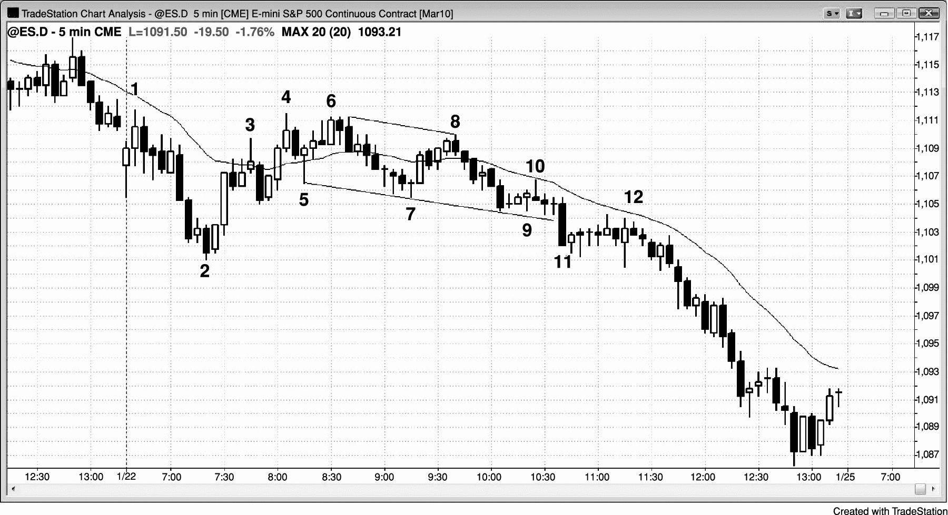
FIGURE 18.9 Failed Wedge Bull Flag

